Slide 1

Student Project Tracking System
SOA Project Review-2
Thursday, October 01th, 2026
 | Under the Guidance of Mrs. E. Uma Shankari, Assistant Professor, Department of Computer Science and Engineering, KLH CSE Bowrampet Campus
Team Members M. Venkata Avinash – 2420030458 Cherishma Sana – 2420030319 M. Hemanth Sai – 2420030526 K. Vishnu Vardhan - 2420030515

Slide 2
Outline of Project Work
Focus
Introduction
Problem Statement
Objectives
Project Architecture
Methodology Adopted
Project Design
Technical Soundness of the Project

Slide 3
Problem Statement
Educational institutions often manage student projects using manual records, spreadsheets, emails, messaging applications, and disconnected systems. This makes it difficult for faculty to continuously monitor project progress, assign and track tasks, manage submissions, provide feedback, and identify projects that are falling behind schedule.
Students also face difficulties in keeping track of project requirements, assigned tasks, deadlines, submissions, and faculty feedback because project-related information is scattered across different platforms.
Therefore, there is a need for a centralized Student Project Tracking System that provides a single platform for students and faculty to manage and monitor the complete project lifecycle.
The system should support project management, task tracking, submission management, feedback, notifications, and progress monitoring while using a Service-Oriented Architecture (SOA) and microservices-based approach to achieve scalability, modularity, maintainability, and fault isolation.
Technical Soundness of the Project
SOA Project Review-2
01 October 2026

Slide 4
Objectives
To develop a centralized web-based system for managing and tracking student projects.
To enable students to create, update, and manage project details throughout the project lifecycle.
To provide an efficient mechanism for assigning, tracking, and updating project tasks.
To enable students to upload project submissions and receive faculty feedback.
To help faculty monitor project progress, deadlines, tasks, and submissions from a single platform.
To provide notifications for task assignments, approaching deadlines, submissions, and feedback.
To improve communication and coordination between students and faculty.
To implement SOA and microservices architecture for modularity, scalability, and maintainability.
01 October 2026
SOA Project Review-2

Slide 5
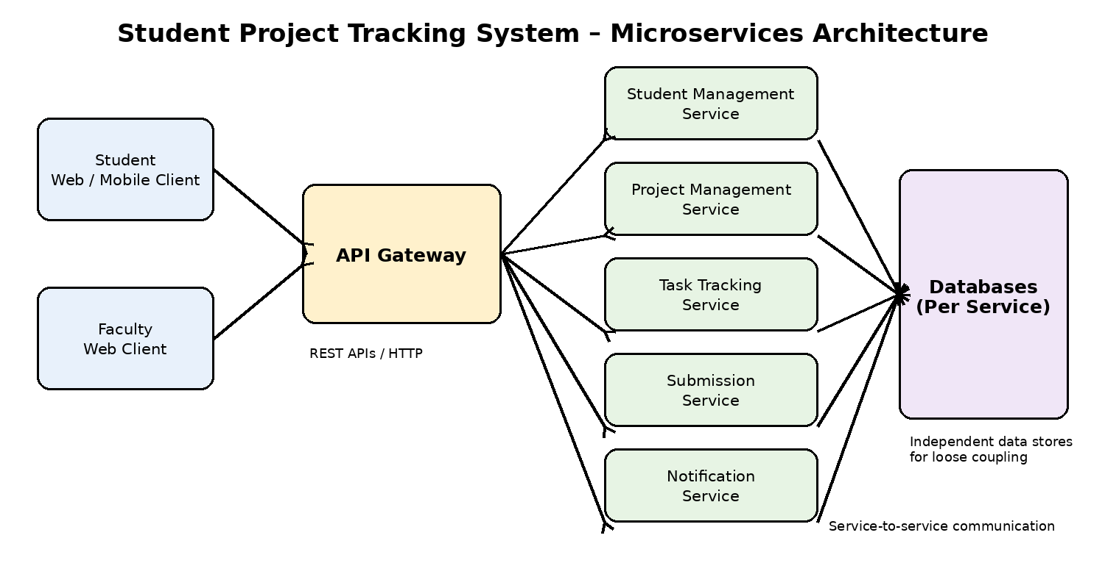
Project Architecture
01 October 2026
SOA Project Review-2

Slide 6
Methodology Adopted
Requirement analysis was carried out to identify student and faculty project management needs.
The system was divided into independent microservices based on functionality.
REST APIs are used for communication between the frontend, gateway, and backend services.
Each service is developed and integrated with its respective database.
Testing includes service-level, API, integration, and complete system testing.
Development follows the phases: Requirement Analysis → Design → Development → Integration → Testing → Deployment.
01 October 2026
SOA Project Review-2

Slide 7
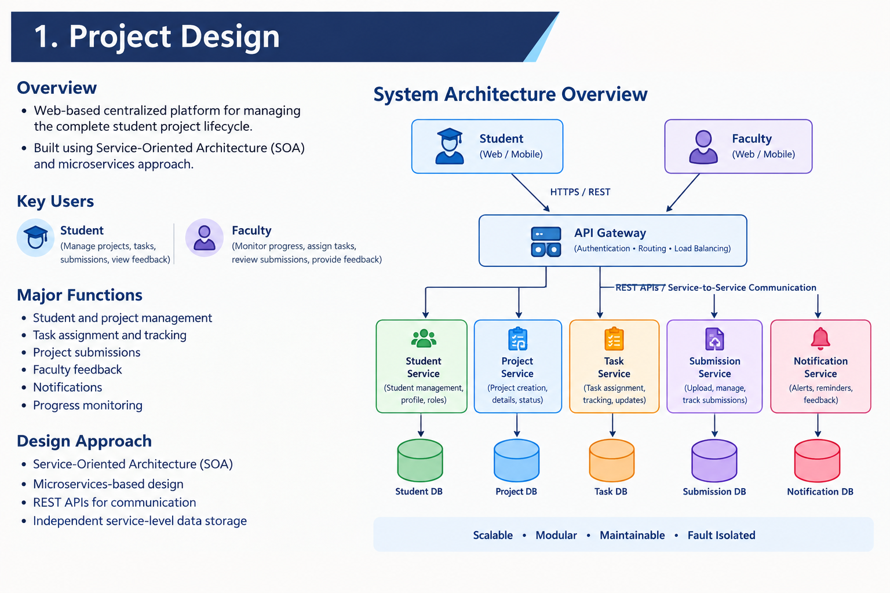
Project Design
01 October 2026
SOA Project Review-2

Slide 8
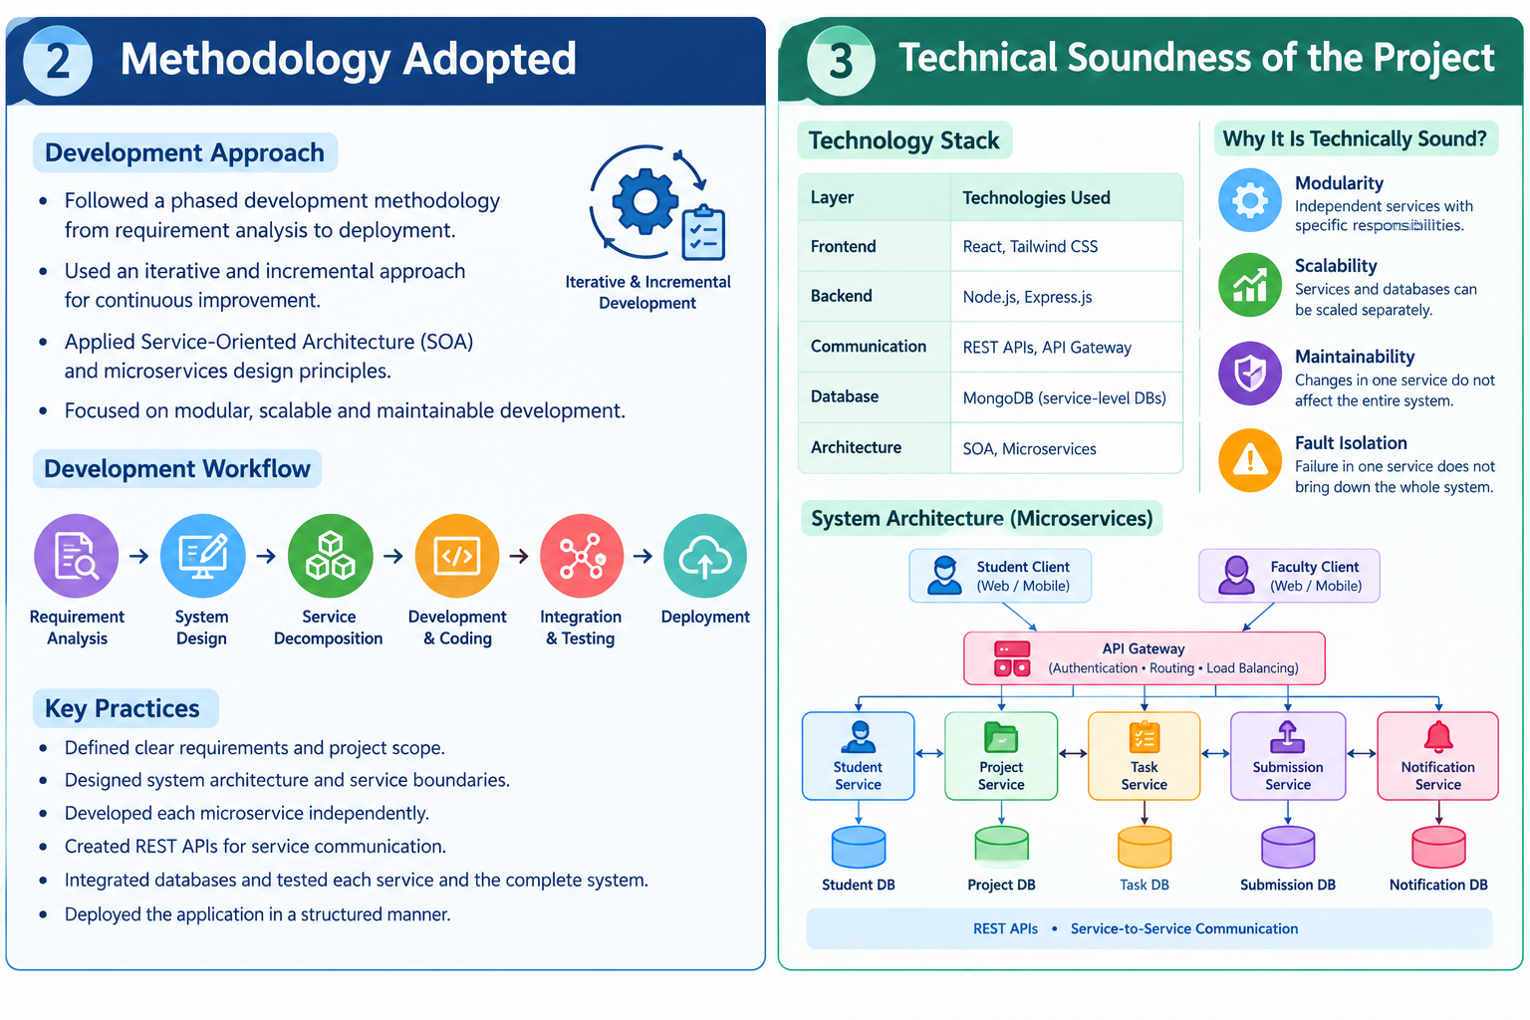
Technical Soundness of the Project
SOA and Microservices: Provides modular and independent service development.
REST APIs: Enable communication between clients and backend services.
Scalability: Individual services can be scaled based on system requirements.
Maintainability: Changes in one service can be made without affecting the complete system.
Fault Isolation: Failure in one service can be isolated from other services.
01 October 2026
SOA Project Review-2

Slide 9
Conclusion
The proposed Student Project Tracking System provides a centralized platform for managing the complete student project lifecycle.
The SOA and microservices architecture supports modularity, scalability, maintainability, and fault isolation.
REST APIs enable communication between the frontend and individual backend services.
The methodology provides a structured approach from requirement analysis to testing and deployment.
The system addresses major gaps such as fragmented communication, limited progress tracking, and manual monitoring.
The proposed design provides a strong foundation for implementation, integration, testing, and future deployment.
01 October 2026
SOA Project Review-2

